Slide 1

Churn Prediction Application
BY:
YERUVA JEEVAN REDDY

Slide 2
I am enthusiastic about data science, especially considering how quickly technology is changing the profession. I enjoy being a part of new technologies and trying out innovative solutions
About us :
NAME : YERUVA JEEVAN REDDY
QUALIFICATION : B. Tech. honours (COMPUTER SCIENCE AND ENGINEERING.)

Slide 3
Description of a Machine Learning Project
Introduction
Problem Statement
Tools (Libraries) used
Website URL’s for Web-Scrapping
Raw Data
Data Cleaning and Data Manipulation
Cleaned Data
EDA (Uni, Bi and Multi - variate Data analysis using graphs)
Challenges
Conclusion
Titles | Description
Project Title | Customer Churn Prediction
Project Domain | Telecom Domain
Type of Machine Learning | Supervised Machine Learning
Type of Problem | Classification Problem
Project Methodology | CRISP ML-Q Methodology
Project Deployment | Streamlit

Slide 4
Workflow for CRISP-DM Methodology
Business problem understanding
Data collection and understanding
Exploratory data analysis
Data preparation
Data cleaning
Feature engineering
Machine learning model building
Machine learning model evaluation
Machine learning model deployment using Streamlit
Use this workflow as a guide to help you predict customer churn with machine learning.

Slide 5
Business problem understanding
Introduction to Telecom Churn Prediction
Telecom companies face a common challenge of retaining customers and reducing churn rates.
Churn refers to the phenomenon where customers discontinue their services with the telecom provider.
High churn rates can have significant negative impacts on revenue and profitability.

Slide 6
Business problem understanding
Importance of Churn Prediction
Predicting customer churn is crucial for telecom companies to take proactive measures to retain customers and minimize revenue loss.
By identifying customers at risk of churning, telecom companies can implement targeted retention strategies, such as personalized offers or improved customer service.

Slide 7
Data collection and understanding
Introduction to Dataset
The dataset used in this project is sourced from https://www.kaggle.com/c/customer-churn-prediction-2020/data?select=test.csv
It is having 4250 of records and 20 of features, providing a comprehensive view of customer interactions and behaviors.
The dataset includes various attributes such as demographic information, customer usage patterns, and churn status.

Slide 8
state : 2-letter code of the US state of customer residence
account_length : Number of months the customer has been with the current telco provider
area_code : "area_code_AAA" where AAA = 3 digit area code
international_plan : The customer has international plan (yes/no)
voice_mail_plan : The customer has voice mail plan (yes/no)
number_vmail_messages : Number of voice-mail messages
total_day_minutes : Total minutes of day calls
total_day_calls : Total number of day calls
total_day_charge : Total charge of day calls
total_eve_minutes : Total minutes of evening calls
total_eve_calls : Total number of evening calls
total_eve_charge : Total charge of evening calls
total_night_minutes : Total minutes of night calls
total_night_calls : Total number of night calls
total_night_charge : Total charge of night calls
total_intl_minutes : Total minutes of international calls
total_intl_calls : Total number of international calls
total_intl_charge : Total charge of international calls
number_customer_service_calls : Number of calls to customer service
churn : Customer churn - target variable (yes/no)

Slide 9
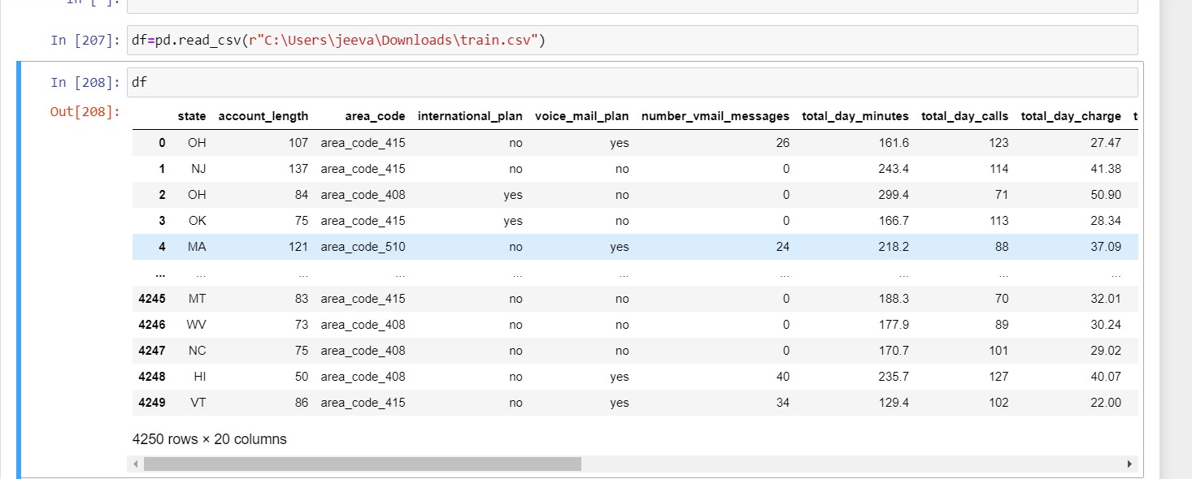
Data Set

Slide 10
Data Cleaning
Conversion of Area Codes to Numeric :
Numeric area codes, previously represented as strings (e.g., "area_code_415"), have been converted to their respective numerical values (e.g., 415).
This conversion streamlines the representation of area codes and facilitates numerical analysis.
Data Type Conversion:
Data types of various features have been adjusted to their appropriate types.
Ensuring consistent data types improves computational efficiency and supports accurate analysis.

Slide 11
Data Preparation
Transformation of Categorical Variables:
Categorical variables such as "state," "churn," "international_plan," and "voice_mail_plan" have been transformed into numerical representations using one-hot encoding.
Removing the outliers by inter quartile method.
Resulting Dataset Overview
After data cleaning and preparation, the dataset is structured and formatted for effective analysis and modeling.
Numeric area codes and consistent data types enhance computational efficiency and accuracy.
Transformed categorical variables enable the utilization of rich customer information in predictive modeling.

Slide 12
Feature Engineering Overview
Introduction
Feature engineering is a crucial step in machine learning projects, involving the creation of new features from existing ones to improve model performance and capture relevant information. In our churn prediction project, we implemented several feature engineering techniques to enhance the predictive power of our models.
List of features created:
Total Minutes of the plan(`total_min`)
Total Calls of the plan(`total_call`)
Total Charge of the plan(`total_charge`)
No of Day of the plan(`plan_day`)
No of Weeks of the plan(`plan_weeks`)
No of Years of the plan(`plan_years`)
Charge of the plan per each Day(`charge_day`)

Slide 13
Machine Learning Model Building
Introduction
In our churn prediction project, building an accurate and reliable machine learning model is essential for identifying customers at risk of churn.
Model Architecture
Our machine learning pipeline comprises two key components:
Data Preprocessing:
Utilizing the ColumnTransformer from scikit-learn, we applied one-hot encoding to categorical variables and retained numerical variables.
The pipeline handles feature transformation seamlessly, ensuring compatibility with the decision tree classifier.

Slide 14
Machine Learning Model Building
Decision Tree Classifier:
Employing a decision tree classifier, we constructed a predictive model capable of discerning patterns in customer data to forecast churn likelihood.
Key hyperparameters such as splitter, criterion, max_depth, min_samples_split, and min_samples_leaf were fine-tuned to optimize model performance.
Model Training
We split our dataset into training and testing sets using a 60/40 ratio, ensuring a robust evaluation of model performance.
The training data was used to fit the machine learning pipeline, enabling the model to learn patterns and relationships in the data.

Slide 15
Machine learning model evaluation
Model Evaluation
The model's performance on the test dataset using various evaluation metrics such as accuracy, precision, recall, F1 score, and ROC AUC.
The decision tree classifier exhibited promising results, demonstrating its efficacy in predicting customer churn accurately.
Testing Scores:
Accuracy :0.9680392156862746
Precision : 0.8958414748578683
Recall : 0.7966666666666667
F1 Score : 0.8482961316914473
ROC AUC Score : 0.8960582375478926

Slide 16
Machine Learning Model Deployment using Streamlit
Introduction
Streamlit is a powerful and user-friendly framework for building interactive web applications
with Python.
Key Features of Streamlit:
Ease of Use, Interactive Widgets, Real-time Updates, Customized Options

Slide 17
Machine Learning Model Deployment using Streamlit
Model Deployment Process
Preparing the Model: Before deployment, the machine learning model must be trained and saved in a serialized format (e.g., pickle or joblib).
Building the Streamlit App: Using Streamlit, we develop a web application that loads the trained model, accepts user input, and provides predictions based on the model's output.
User Interface Design: We design an intuitive and user-friendly interface for the Streamlit app, incorporating interactive widgets and informative visuals to enhance user engagement.

Slide 18
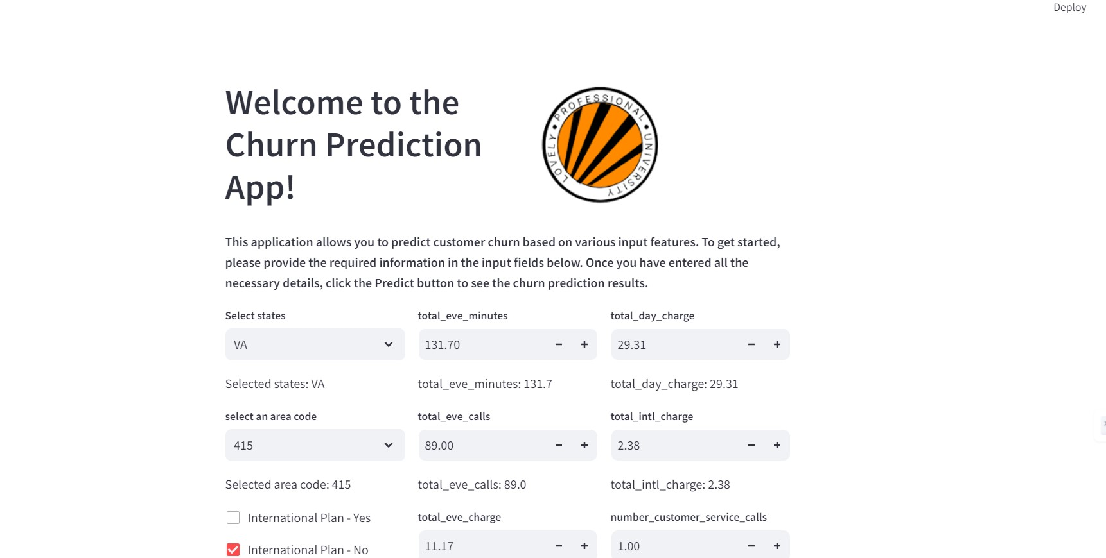
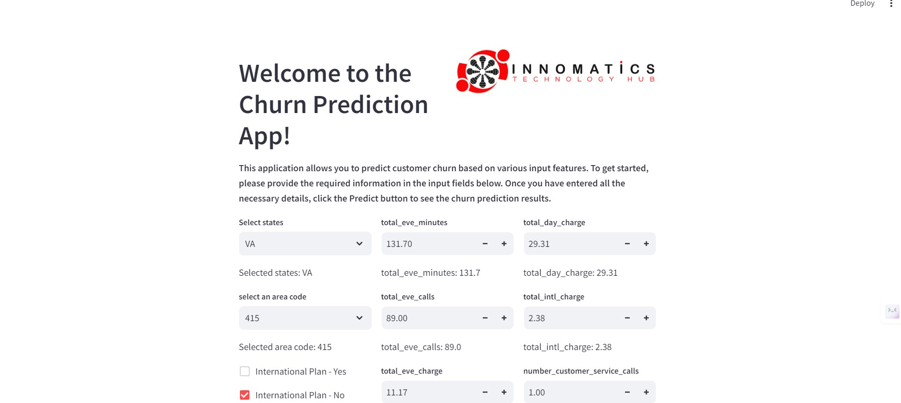

Slide 19
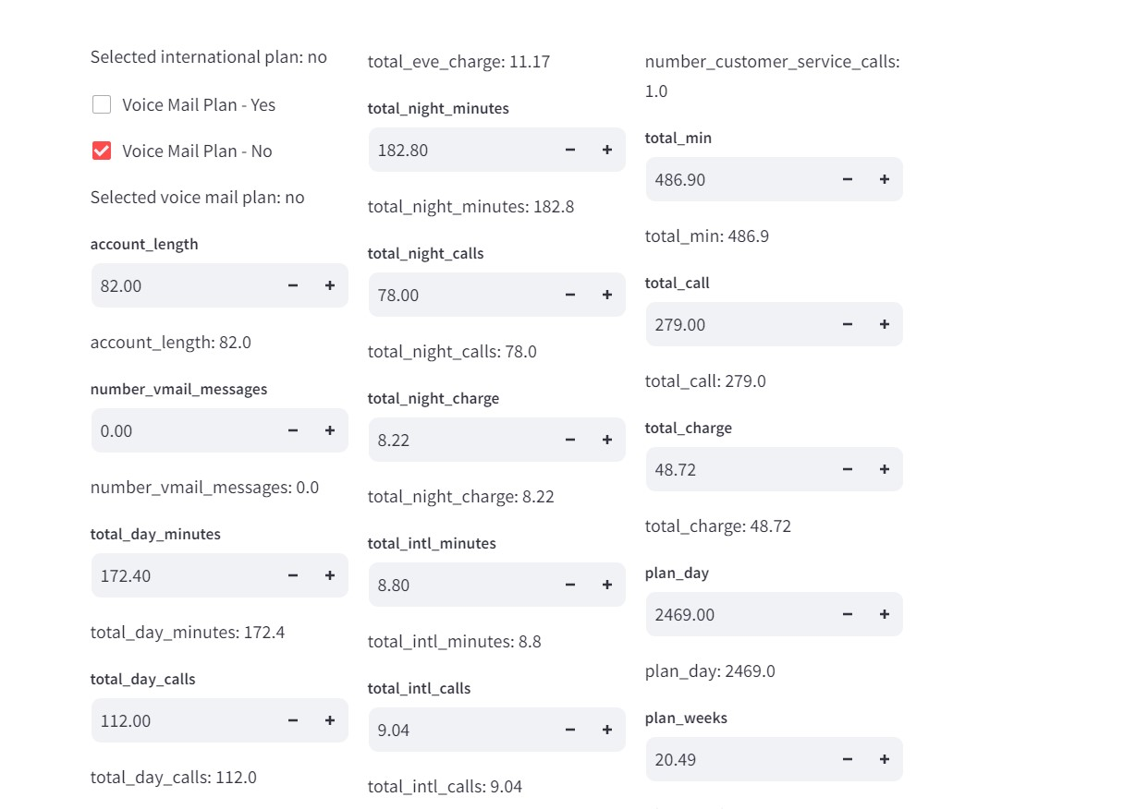

Slide 20
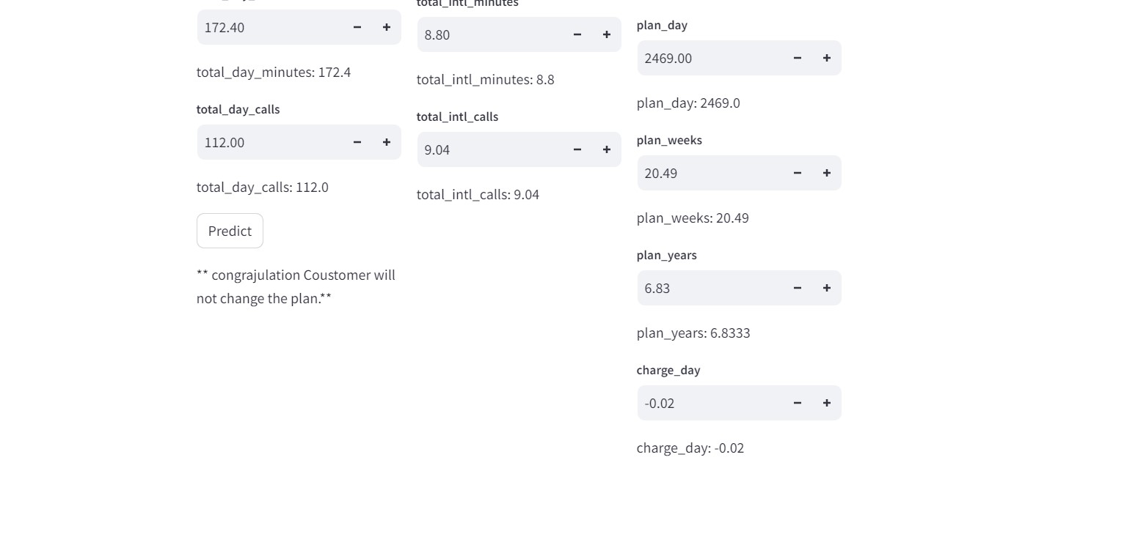

Slide 21
Conclusion
This machine learning model, powered by a decision tree classifier, represents a valuable tool for telecom companies to proactively identify and retain customers at risk of churn.
Continual refinement and optimization of the model will be crucial for maintaining its effectiveness in a dynamic business environment.

Slide 22
Thank you

